Slide 1

ECON 1BB3 – Introduction to Macroeconomics

Slide 2
Interest rates in a small open economy
open economy: allows goods, services, and capital to flow across borders freely
small open economy (SOE): not large enough to affect world interest rates or world prices
perfect capital mobility: full access to world financial markets
Example: Canada!
Notes:
Large open economy is the economy that is big enough to influence world interest rates and world prices
Perfect capital mobility
No restrictions on foreigners owning domestic asset
No restrictions on Canada owning foreign assets
There is only one closed economy in the world: N.Korea (doesn’t trade)
There are about 4 entities that are large open economies (China, US, Europe, Japan)
Other countries fall into small open economies including Canada
Large open economies can sometimes be treated as they are closed (answers you get will be similar)

Slide 3
Interest rates in a SOE
Interest rate parity = in theory, the real interest rate (in Canada) should equal real interest in world financial markets
r = r^{w}
^{Why? → graph on the next page}
Interest Rate parity is not always perfect for two reasons:
  1) Risk (risk premium)
  2) Tax treatment (we care about the after-tax real interest rate)
Notes:
Not realistic, but need a simple model.
This is important b/c most models are SOE.
LOE = US, Japan, Europe, China

Slide 4
Model of a small open economy
S^{w}
r
D^{w}
Q of LF
World market for loanable funds
Notes:
Assuming firms only invest.
There is an outward shift in the D(w). But it’s not big enough to influence (red line).
Countries perceived to have a higher risk will have a higher interest risk. Care about the after-tax real rate of return.
Canada implemented tax-free saving accounts → incenttive to save me
What happens to world market? → supply of LF will barely shift outward (changes within the country will not affect the world) However if ppl in the US increased savings, it would actually shift supply curve

Slide 5
Model of a small open economy
two markets: market for loanable funds AND market for foreign currency
loanable funds
  S – I = NCO (open)
  S = I (closed)
in a closed economy, the interest rate adjusts to bring S into line with I
in an SOE, we take the world interest rate as given →
(r = r^{w}) we figure out NCO (difference between S and I)
Notes:
The model on Friday is very complicated. It has two diagrams
In a closed economy, the interest rate adjusts in order to bring S into line with I. In open, we take world interest rate as given to us (r = r^{w})
Likely never reach equilibrium in a SOE.

Slide 6
Model of a small open economy
S
S > I → NCO > 0
lending to foreigners
r
NCO¹
r^{w}
D
Q of LF
I¹
S¹
Notes:
If world interest rate is above eqm. Qs > Qd → lending the excess saving to foreigners
3 curves can shift.
PURCHASE FOREIGN ASSETS (cause NCO to go up) to lend money out to foreighners

Slide 7
Model of a small open economy
S
S < I → NCO < 0
borrowing from foreigners
r
r^{w}
D
Q of LF
Notes:
Qd > Qs (by households and governments).
Firms are borrowing from foreigners.
Before, we had a trade surplus. Now, Canada is like (^^^)
CANADIAN ARE BORROWING FROM FOREIGNERS (they issue bonds) that’s how funds are flowing into Canada

Slide 8

Market for foreign currency
supply, demand of $CAD on foreign currency market
artificially divide foreign exchange transactions
trying to determine RER:
Notes:
In reality: Firms save, govt and household borrow
Assume all savings done by govt and household, and firms do the borrowing
In this market
(The demand, we are buying foreign currency and using CAD t
supply for CAN is OUR demand of foreign currency
THEY Demand for CAN is the supply of foreign currency
On graph:
Supply of CAN to buy imports!!
Demand of CAN to sell exports!!
Y-axis is the real exchange rate (eP/P*)
Artiically divide transactions:
-when we buy from foreign, we need to buy foreign currecny, therefore we need to supply CAN into market for foreign currency (import we supply CAN)
-when we export, it generates demand for CAN because foregin countries need to buy CAN currency first
For NCO, foreigners who wana buy canadian asset, first they need to buy CAN dollars. That generates a demand for CAN dollars
When foreign buy form us, they need to buy CAN currency, therefore they need to supply foreign curency.
When foreign export to us, we need to buiy foreign cucrency, therefore we demand CAN currency

Slide 9
Market for foreign currency
  Supply, demand of $CAD on foreign currency market
  Artificially divide foreign exchange transactions
  Trying to determine RER:
  (eP/P*)
  ---------------------------------------------------------------------------
  supply – from NCO, a Canadian purchase of foreign assets (we are supplying $CAD, demanding for currency)
  demand – from NX, foreigners wanting to buy $CAD (because they want to buy Canadian goods)
Notes:
Real exchange rate (eP/P*). Vertical axis = exchange rate. Horizontal = quantity of Canadian dollars demanded
Purchasing more foreign asset than Canadians producing. When buy foreign currency, we are at the same time…
If net exports are positive, we’re selling to foreigners more than
Demand for Canadian dollars only from net exports.
Assume NCO is positive
If NCO in Canada is positive, we are buying more asset from foreigners than they are buying form us even though both are buying from each other (generate the supply of CAN dollars)
NX is positive
Foreigners get more of our dollars than we need of their currency to finance the trade. We assume thje dmand for CAN dollars from the NX
NCO = NX (the RER will adjust to bring these two values into line)

Slide 10

The market for foreign-currency exchange
RER
S (=NCO)
B
A
D (=NX)
NCO = NX
Q of $CAD
Notes:
If the domestic price goes up, imports of foreign goods will increase.
If P goes up, exports go down → negative slope.
Negative relationship b/w Q of $CAD and RER
When RER increases, net exports decrease (shift S). It doesn’t matter what the RER is, the supply of export into and out of Q of $CAD is the same.
__________________
-supply of CAN dollars comes from NCO
-comes from list of factors tha tinfluence NCO (not price, nomin. Ex rates.) it is domestic and foreign interest rates, govt policites, and maybe risk?
-if eP go up (domestic), canadian goods become more expensive, we move up the stationary** D curve (form A to B)
-other factors like taste will shift the demand curve

Slide 11
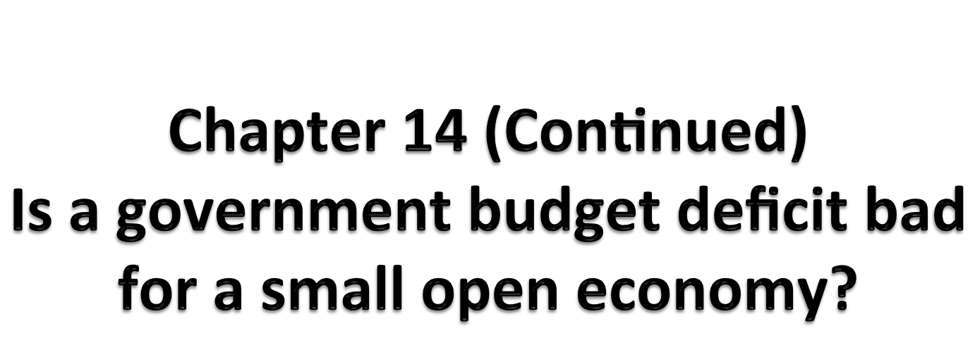
ECON 1BB3 – Introduction to Macroeconomics

Slide 12
The market for foreign-currency exchange
RER
S (=NCO)
D (=NX)
80
Q of $CAD
Notes:
NCO and NX are positive always
NCO → Canadiana pruchase more foreign assets than foreigners purchse can assets (we need to buy/demand for foreign currecy, it is the supply of CAN dollar)
When foreign buy stuff from us, demand for CAN comes from NX
NX depend on RER = eP/P* (what happens when each variable change?)
Moving along fixed demand curve

Slide 13
Model of a small open economy
S
r
D
Q of LF
Notes:
80 = Qd – Qs → which is from

Slide 14
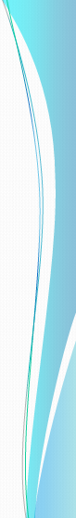
The real equilibrium in an SOE
r
S (S_{g} + S_{p})
r_{w}
NCO = 50
D (I)
I
S
Q of LF
Mkt for LF
RER
S(NCO)
RER
D (NX)
50
Q of $CAD
Mkt for foreign-ex (FEX)
Notes:
Supply curve on the bottom diagram is determined by the top diagram.
Net capital outflow is always positive. World interest rate is above eqm in the top diagram.
Reminders next to S and D on the top diagram b/c…
Public saving, private saving, investment
Change in those variables are causing the S and D curves to shift
Shock to the system
Which diagram → which curve is affected → what shift occurs → this also changes the bottom diagram curve
______________________
r -
S
I
Sp
Sg
NCO
NX
RER

Slide 15
r
S (S_{g} + S_{p})
r_{w}
Effects of an increase in the world interest rate
r_{w}
D (I)
I
S
Q of LF
Mkt for LF
RER
S(NCO)
RER₁
D (NX)
Mkt for forex
Q of $CAD
Notes:
Rw increases S increases I decreases NCO increases (this changes position of the S on the bottom diagram; RER decreases, NX increases (makes sense since NCO = NX.
Interest rate adjusts to bring
In equilibrium, NCO = NX. NCO = domestic purchase of foreign asset – foreigner purchase of domestic products.
If the world interest rate increases.
________________
The bottom diagram is very similar to closed economy M of LF
r - shift up
S – increase to the right (when interest rate goes up, private saving goes up)
I – decrease to the left (don’t want ot borrow as nuch because of hgigher interst rate)
Sgovt – no effect (T-G)
Spriv – Increase
NCO –(shift to the right (increase)
NX – increase with NCO (more savings, higher interest, fewer firms borrow, lend it to foreign firms who do want to invest, supplying CAN into foreign curency, downward pressure on RER (and price goes down), therefore NX goes up
→ RER adjusts to make sure NCO = NX
RER – goes down (intersection with D or NX is lower)
NO CAPITAL FLIGHT

Slide 16
r
S (S_{g} + S_{p})
Effects of an increase in the government budget deficit
r_{w}
D (I)
Mkt for LF
Q of LF
RER
S(NCO)
RER₁
D (NX)
Mkt for forex
Q of $CAD
Notes:
Sg becomes more negative, a decrease in public saving.
If NCO > 0, don’t draw the red lines. Top red line → NCO < 0
Draw green line, new Rw better.
Lower investment now = lower future capital stock.
Decrease Sg, decrease NCO, increase RER, NX decreases
Big budget deficit = trade budget deficit.
Investment doesn’t change.
SOE, shift supply curve out to the right; won’ affect world interest rate.
Increase RER, buy more stuff;
If e increases, can buy more, NX decreases b/c our stuff is cheaper
__________________________
Increase G, therefore less S (left shift)
If shifted to blue line, you get negative NCO
If shfifted to red line, you get 0 NCO
Therefore only shift to green curve
r - no change
S - decrease
I – no change
Sp – no change (it depends on interst rate)
Sg – decrease
NCO – decrease (savings went down)
NX – decrease
→ NCO decrease Don’t need to buy foreign currecnty, don’t buy as much foreign asset, not supplying as much CAN (duspply decrease), upward pressure on RER (prices go up), so we buy more foreign goods and foreign buys less of our goods, so NX decrease
RER - increase

Slide 17
r
S (S_{g} + S_{p})
r_{w}
Imposing an import quota /tarriff
D (I)
I
S
Mkt for LF
Q of LF
RER
S(NCO)
RER₁
D (NX)
Mkt for forex
Q of $CAD
Notes:
Demand curve is affected in the bottom diagram first. This is because there is a restriction.
NX = E – I. and cut imports; demand curve is affected. D curve will shift out to the right. Initially, RER increases b/c the dollar is more valuable. Exports go down. NX doesn’t change.
NX = E – I. NX same; E decreases; Imports decrease. Why doesn’t NX change? @ equilibrium, they are equal to each other. If nothing changes in the top diagram. If want to make NX bigger and am a SOE, then what? Either have to get government or households to save more. Lower investment = lower potential GDP.
In this situation, trade policy doesn’t affect trade balance. Different model for the US b/c it is a LOE.
If want to affect trade balance, have to affect NCO b/c either exchanging goods or
IMPORT QUOTAS
We want a bigger trading surplus
Restriction on amount of imports
Put in tariff or just limit amount of units that comes into the country
NX = Ex – Im, so Ex get bigger
TRADE POLICY does not affect trade balance for a small open economy
r - no change
S – no change
I – no change
Sp – no change
Sg – no change
NCO – no change
NX – no change
Imports go down BUT we have excess demand for CAN dollars at initial RER, cause upward pressure on RER, make our goods more expensive, cut back on NX, less foregin buying our goods.
How to fix it? To increase trade balance Is to NCO (cut I or increase S), therefore need to raise taxes or cut gov’t spending
RER – increase (value of dollar appreciates due to icnrease in demand for dollars which leads to increased RER)
ONLY IF NCO shifts, then r, S, I change

